Slide 1

KNOWLEDGE INSTITUTE OF TECHNOLOGY, SALEM – 637504
(Autonomous Institution)
MAP
2025
FIRST REVIEW
PORTABLE PLANT CUTTER MACHINE
Batch No.: 4
Club Name : SUSTANABLE ENGINEERING CLUB
Team Members: GURU PRASANNA V , KARTHI VS ,KARTHICK SS ,BRAJEETH G, THIRAGANTH J
Full Affiliation: III Year , Knowledge Institute of Technology. Salem.
Name of the Mentor: MR: KARHICK KN
Presentation Date: 18/09/25

Slide 2
Table of Content
List of Problems through customers / industry defined problems
Selected Final Problem Statement (Tentative through KIOT faculty mentor)
Plan to execute
References if any

Slide 3
List of Problems through customers / industry defined problems
 | Short Summary of Problem Statement | Problem identified through (direct customer, industry, SIH contest, other contest etc.) | Align with SDGs (SDG 1 to SDG17)
Problem Statement 1 | BLADELESS WIND TURBINE | SOLAR CUSTOMER | SDG07
Problem Statement 2 | SMART TECHNOLOGY ANTENNA DTH | DTH CUSTOMER | SDG13
Problem Statement 3 | SMART BUCKET | MARKET ,HOTEL MANAGEMENT | SDG03
Problem Statement 4 | SMART WEAVING BUZZER SYSTEM | AUTOLOOMS CUSTOMER | SDG09
Problem Statement 5 | PORTABLE PLANT CUUTER MACHINE | HIGHWAY MAY MAINTANCE | SDG07

Slide 4
FINAL STATEMENT- METAL DUST COLLECTOR
Problem — Manual plant cutting is labor-intensive, time-consuming, and causes operator fatigue, demanding a mechanized solution. Solution — A wheeled, motorized cutter using dual DC Motor 775s with rotating blades for efficient and precise trimming. Power & Mobility — Powered by a 12V 7.5 Ah rechargeable battery and mounted on a wheeled frame for easy portability across fields. Impact — Reduces human effort, increases productivity, and provides a low-cost alternative for nurseries, farms, and greenhouses.

Slide 5
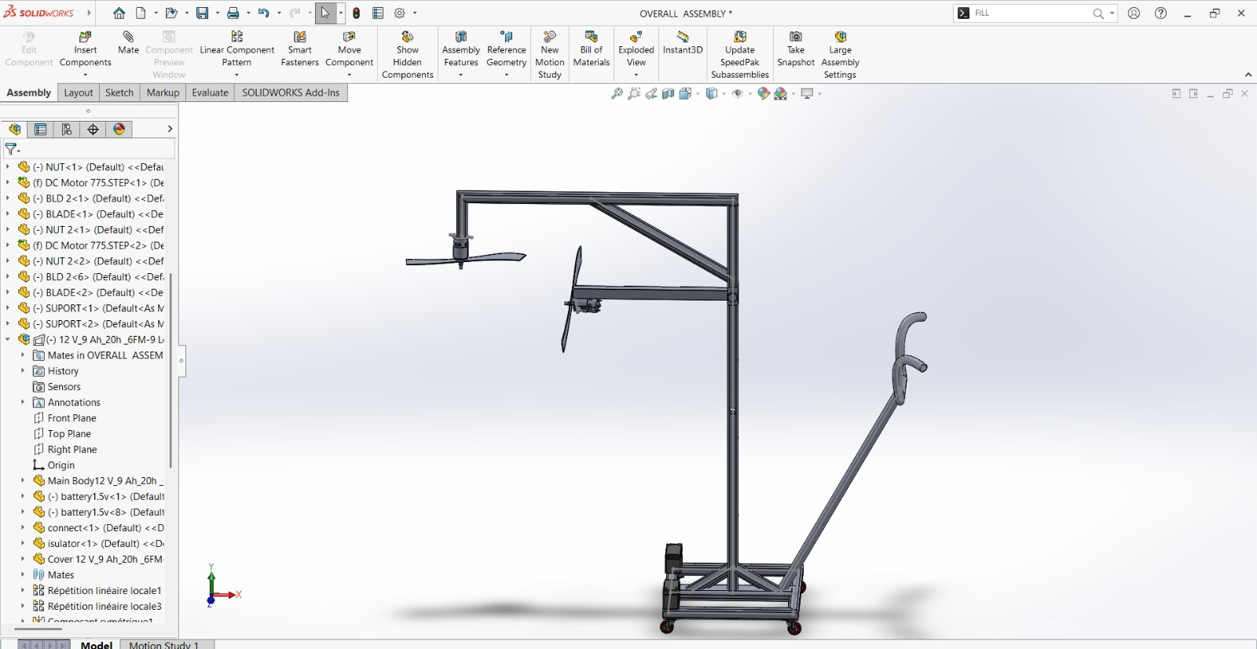
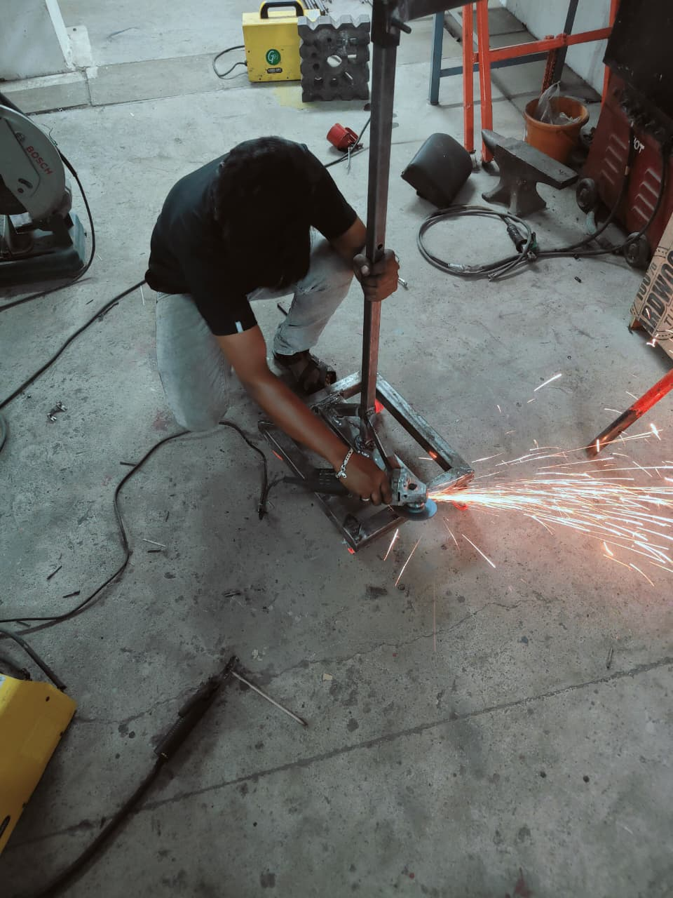
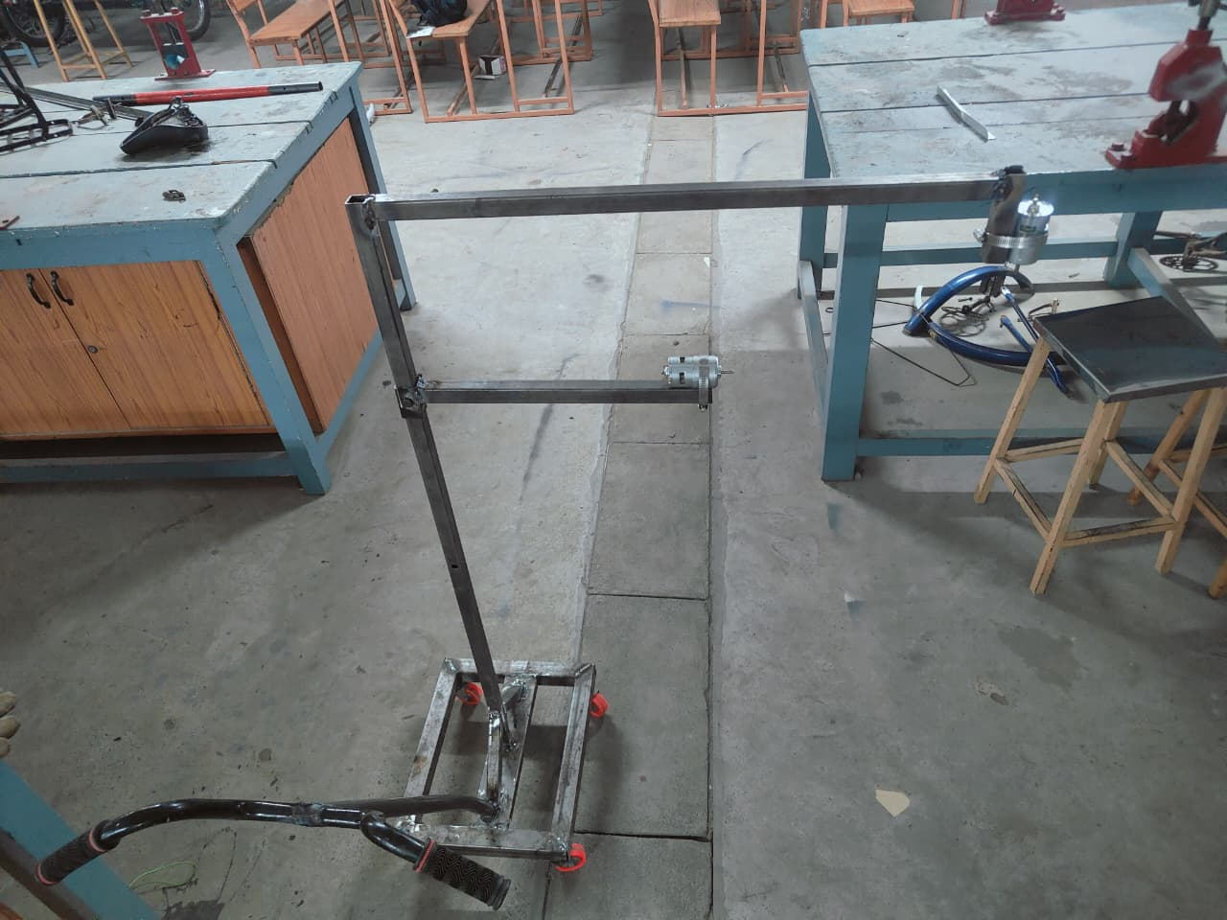
Plan to Execute (Tentative)

Slide 6
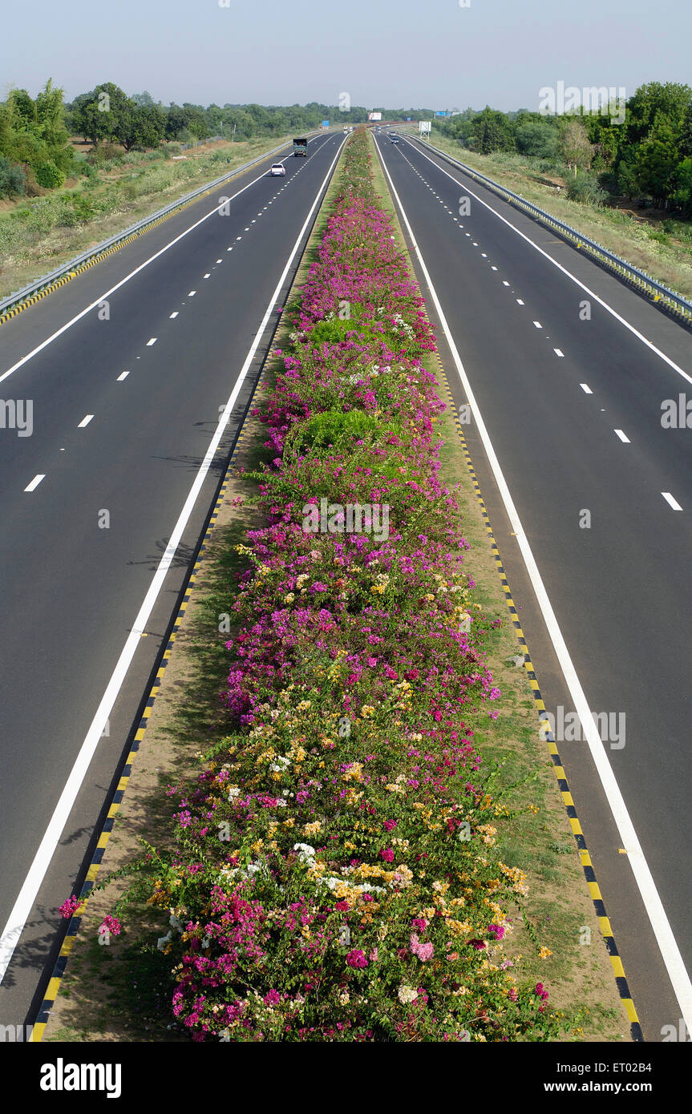
References
Research papers on magnetic separation and dust collection .
Workshop manuals on grinding machine safety
.Online resources about electromagnetic applications in industry

